Slide 1
Mobility Project Voucher (MPV) Application Phase 2
Walkthrough
5.18.2023
Clean Mobility Options
Notes:
Mateo Slides 1-21
Joey Slides 22-52
Mateo Slides 53-58
Joey advance slides the entire time
Mateo provide script in teams
Make Nour Cohost
Set recording and transcriptions-Mateo
Drop links- Diana, Nour, and Katie

Slide 2
CONGRATULATIONS
on advancing to CMO’s Mobility Project Voucher Application Phase 2

Slide 3
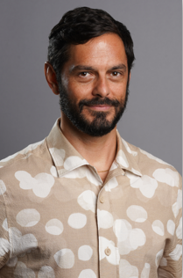
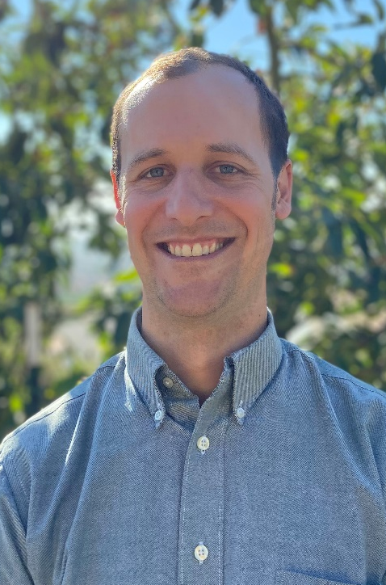
Clean Mobility Options (CMO) Presenters
Joey Juhasz-Lukomski
Mateo Henderson
CMO Program Administrator
CMO Program Administrator

Slide 4
Program Administration Team
Notes:
With all initiative logos, they must stay proportionate to the original file format. They can be made smaller or larger, but they cannot be thinner or elongated. Because logos come in a variety of sizes, there’s no axiom on ratio/proportions but keep them approximately similar in terms of area.

Slide 5
Agenda
CMO Program Overview​
MPV Application Process
MPV Application Phase 2 Walkthrough
Sections 1-7
MPV Application Phase 2 Recap and Next Steps ​

Slide 6
Poll #1
What is your confidence level towards completing Phase 2 of the MPV Application?
Very confident
Confident
Need support

Slide 7
CMO Program Overview​
This section provides an overview of the program background, goals, voucher types and Technical Assistance.

Slide 8
Program Goals
Increase zero-emission mobility choices for all Californians, including disadvantaged communities, low-income communities, and Tribes.
Fund community-driven mobility solutions by centering the residents’ primary needs.
Improve access to clean mobility options that are safe, reliable, convenient, and affordable to communities throughout California.
Reduce greenhouse gases and criteria pollutants.

Slide 9
Phase 2 Technical Assistance Support
One-on-One Support Available to All Prospective Applicants
Access Assistance:
Regional Cohort Facilitator:
Email communication
Scheduled virtual meetings
Phone calls
Get help with:
Project design
Budget advice and financial sustainability plan
Milestone schedule
Developing partnerships
Community resource contribution
and more
Assistance is NOT:
Filling out application
Writing budget
Notes:
One of CMO’s main assets is the offering of FREE full-cycle technical assistance throughout the program - from pre-application assistance to and through project planning and implementation. CMO’s INDIVIDUALIZED technical assistance has been well utilized, applicants are satisfied, and the TA has been found to be effective.
A couple examples of Technical Assistance support comes in the form of:
Tools and guides to conduct Needs Assessment and Mobility Projects
CMO Hotline, email, Program events and webinars throughout the program duration
Tribal Technical Assistance and Engagement
Education and training, and as needed, in person meeting
Our Technical Assistance Provider works with you to help guide you to creating the best possible project

Slide 10
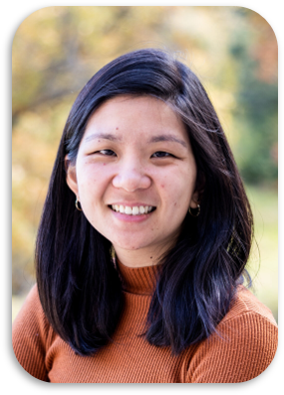
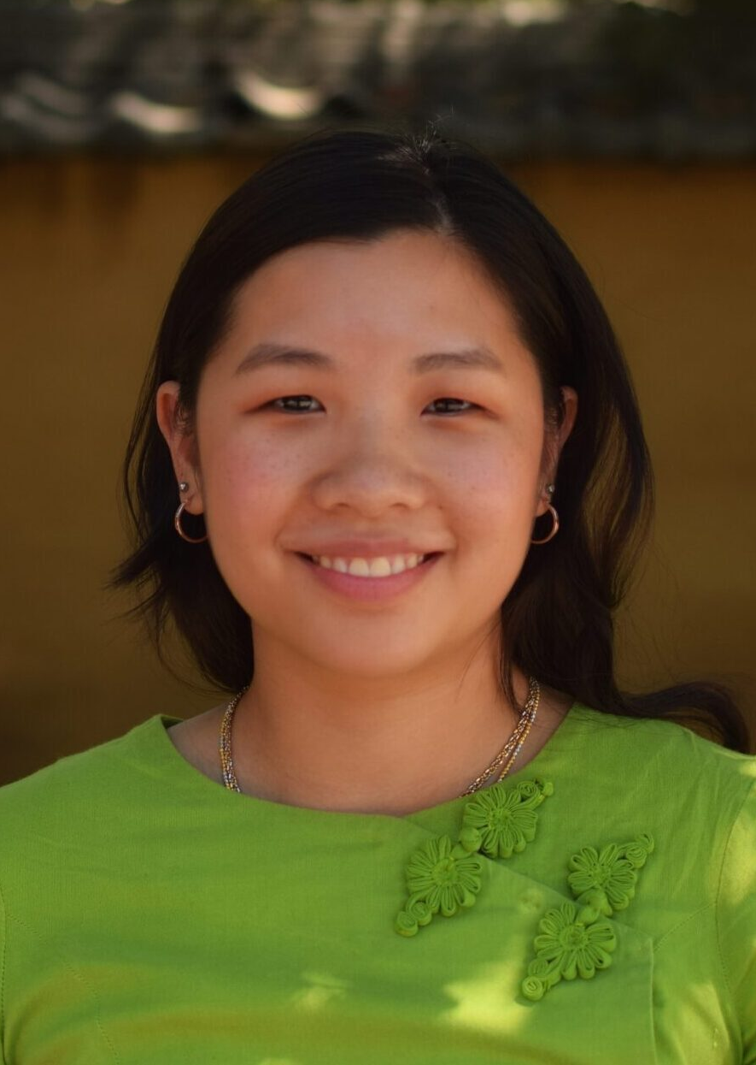
Phase 2 Application Technical Assistance Cohort Facilitators
Northern California
Southern California
Interior California
Sarah Huang
Katarina Hou
Joey Juhasz-Lukomski
Shared Use Mobility Center
Shared Use Mobility Center
Notes:
One of CMO’s main assets is the offering of FREE full-cycle technical assistance throughout the program - from pre-application assistance to and through project planning and implementation. CMO’s INDIVIDUALIZED technical assistance has been well utilized, applicants are satisfied, and the TA has been found to be effective.
A couple examples of Technical Assistance support comes in the form of:
Tools and guides to conduct Needs Assessment and Mobility Projects
CMO Hotline, email, Program events and webinars throughout the program duration
Tribal Technical Assistance and Engagement
Education and training, and as needed, in person meeting
Our Technical Assistance Provider works with you to help guide you to creating the best possible project

Slide 11
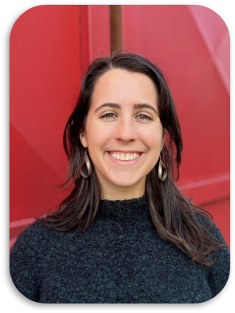
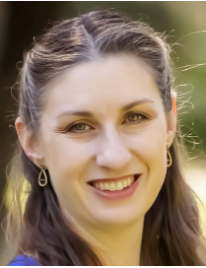
Phase 2 Application Technical Assistance Team
Finance & Insurance
Project Milestones & Voucher Agreement
Tribal Communities
Nour Katabi
Katie Smet
Grace Person
CALSTART
CALSTART
CivicWell
Notes:
One of CMO’s main assets is the offering of FREE full-cycle technical assistance throughout the program - from pre-application assistance to and through project planning and implementation. CMO’s INDIVIDUALIZED technical assistance has been well utilized, applicants are satisfied, and the TA has been found to be effective.
A couple examples of Technical Assistance support comes in the form of:
Tools and guides to conduct Needs Assessment and Mobility Projects
CMO Hotline, email, Program events and webinars throughout the program duration
Tribal Technical Assistance and Engagement
Education and training, and as needed, in person meeting
Our Technical Assistance Provider works with you to help guide you to creating the best possible project

Slide 12
MPV Application Process
This section highlights MPV Application Process and what is needed in Phase 2.
Notes:
The Mobility Project Voucher application consists of two phases, Phase 1 is the Basic Eligibility and open for all applicants, and Phase 2 is Complete Application only for eligible applications that are deemed approved during Phase 1. We will go into this in more detail in the following slides

Slide 13
MPV Application Process (cont'd)
Phase 2
Final Application
Applicants have advanced to Phase 2 and are getting ready to submit their final application.
Notes:
Invite phase 1 applicants to move on to phase 2 only if invited

Slide 14
MPV Application Process
Phase 1
Phase 2
Notice to proceed
Project narrative / team profile details
Project milestone schedule
Community outreach plan
Community resource contribution
Budget worksheet
Financial sustainability plan
Supporting docs (where applicable)
Notes:
Phase 2 is essential final application

Slide 15
Phase 2 Final Application Guidelines
The advancement to Phase 2 of the MPV Application does not guarantee that an award will be granted.
Once the application review process is complete, all Phase 2 applicants will be notified of their status.
Work on the project cannot begin until the Phase 2 application has been approved.
Application submission, review, approval, and Notice of Intent to award is on a rolling basis.
Project costs cannot be reimbursed until the voucher agreement is executed.
MPV PHASE 2
Application Submission
DEADLINE
August 16, 2023
Notes:
Invite phase 1 applicants to move on to phase 2 only if invited

Slide 16
MPV Application Timeline
MPV Phase 1 CLOSED
MPV Notice to Proceed to Phase 2
May 3, 2023
MPV PHASE 2 Application Submission Deadline
August 16, 2023
MPV Notice of Intent to Award
Early Fall
Voucher Agreement Execution
Up to 180 days
Late Spring –Early Fall 2023
Notes:
Inform them that they have up to August date to submit Phase 2, but PA Team is aware that some applicants will submit phase 2 application sooner for review and approval. Once PA team approves application, a notice to award will be sent out which then initiate the Voucher Agreement execution. The VA must be executed with 180 days of Notice to Award. PA team to review and approve up to 6 weeks with clarifications. Emphasize that Application TA is a benefit to streamline review process, etc.
upon submission application review and approval, and Notice of intent to award is on a rolling basis
Depending on when phase 2 application is submitted, the PA team has up to 6 weeks review , clarify and approve. Emphasize that Application TA is a benefit to streamline review process, etc.
NOTES: I’d add in notes that *Notice of Intent to Award is early fall and based on when Phase 2 application is submitted (PA team will have up to 6 weeks to review application).

Slide 17
MPV Phase 2 Application Guide
Phase 2 Application Guide:
To use as a reference throughout application process.
Provides examples and guidance for each step of the application.
https://cleanmobilityoptions.org/mpv-application-phase-2/
Implementation Manual:
For the full program requirements.
cleanmobilityoptions.org/implementation-manual/
Notes:
Application Guide link: https://cleanmobilityoptions.org/na-app-guide-1/
Implementation Manual link: https://cleanmobilityoptions.org/implementation-manual/

Slide 18
MPV Phase 2 Application Overview
Fillable application form
All Phase 2 applicants have access to application via link to access Phase 2 application form.
The Application portal allows you to pick up where you left off.
Applications are not accepted by e-mail.
Notes:
Keep high level..again if invited…..etc. As a reminder app phase 2 can still save applications. And go into further details about your application
Applicants invited to phase 2 will revieve Unique Identifier for Phase 2 application from Program administrator team
In speaking notes, discuss where and when attendees will get access to the application.
In speaking notes, discuss where and when attendees will get access to the application.

Slide 19
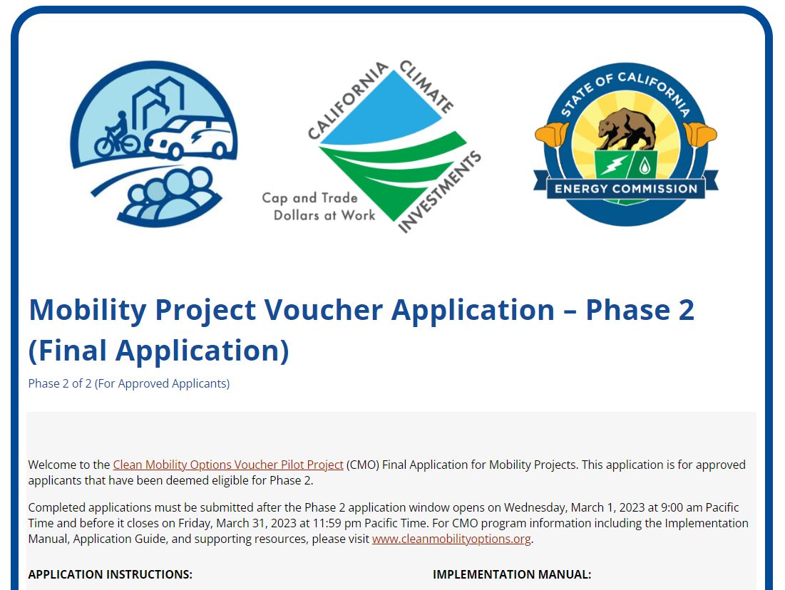
MPV Application Phase 2 Walkthrough
This section covers the step-by-step process of the Phase 2 Application (Sections 1-7).​
Notes:
Mobility Project Application Phase 2 - Clean Mobility Options

Slide 20
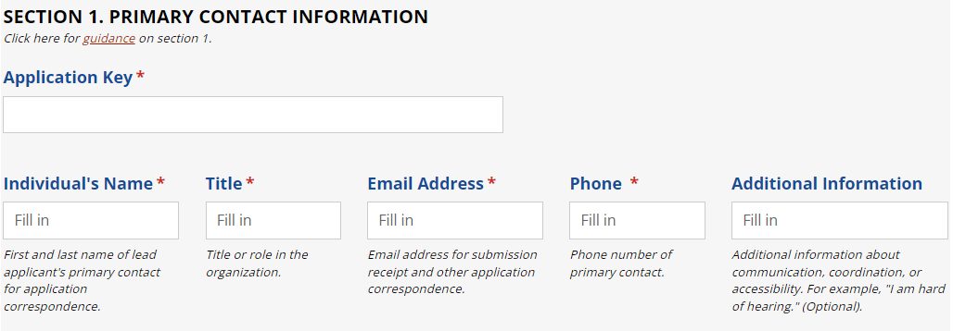
Section 1: Primary Contact Information

Slide 21
Section 1: Primary Contact Information (cont’d)
Neither the Application Key nor the invitation to apply to phase 2 is transferable to another organization. If you cannot locate your Application Key, please contact the Program Administrator for assistance.
Lead Applicant associated with the Application Key is legally responsible for project implementation and oversight of the entire project team.
Primary contact must enter information such as the
individual’s name, title, email address, and phone.
Additional information is optional such as special accessibility needs, secondary means of contact, etc.
Notes:
The unique identifier is used to incorporate the foundational materials submitted in Phase 1 into Phase 2 and allow you to pick up where you left off. This functionality is intended to minimize the need to provide redundant information. Send link
In the [Additional Information], which is optional, please provide any other information that would be helpful for communication and coordination. For example, a secondary means of contact, accessibility issues, other correspondence information if relevant.
Add to notes: the Application Key nor the invitation to apply to Phase 2 is transferable to another organization. If you cannot locate your Application Key, please contact the Program Administrator for assistance.

Slide 22
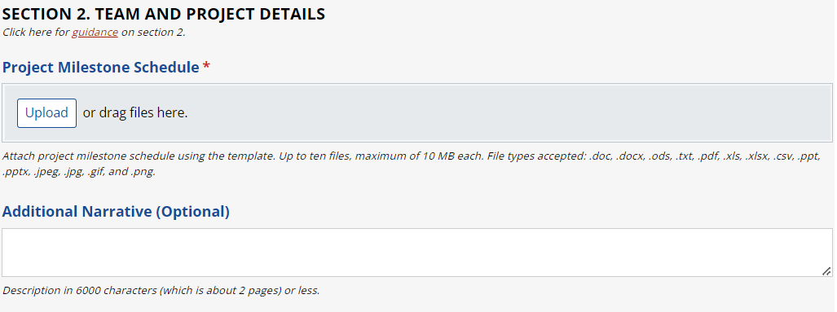
Section 2: Team and Project Details

Slide 23
Section 2: Project Milestone Schedule
In the field "Project Milestone Schedule" upload a Project Milestone Schedule using the template available on the CMO website.
https://cleanmobilityoptions.org/project-milestone-template/
This should include:
Milestones for planning, construction, deployment, operation, and reporting.
Key steps for community engagement.

Slide 24
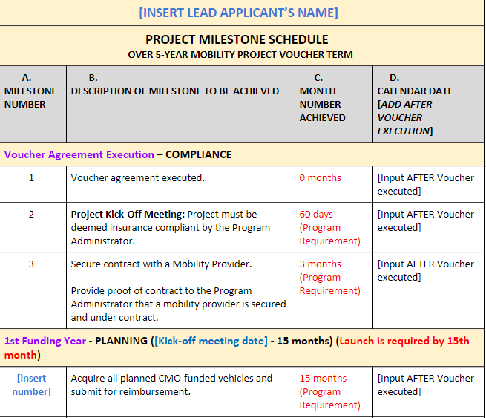
Section 2: Project Milestone Schedule (cont'd)
Example Template:
MPV Project Milestone Schedule

Slide 25
Section 2: Additional Narrative
In the field "Additional Narrative" discuss additional requirements or background related to successfully implementing the project and operating the service.
If the project relies on a public process for any key approvals, or includes an “additional transportation enhancement,” you must describe it here.
You do not need to restate information already given in Phase 1 of the application.

Slide 26
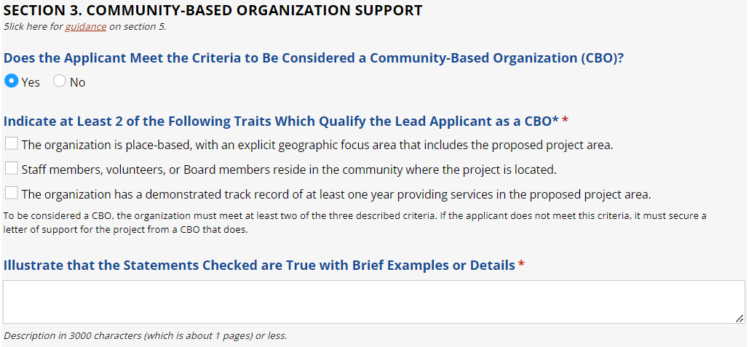
Section 3: Community Based Organization (CBO) Support

Slide 27
Section 3: CBO Support
Tribal Governments are exempt from CBO requirements.
For Applicants that indicate in section 1 they are a Tribal Government, a message will appear saying that they may skip this section, and they will not be shown further questions.

Slide 28
Section 3: CBO Support (cont'd)
Lead Applicants must either be a CBO or submit a letter of support for the proposal from a project-related CBO.
To be considered a CBO in the CMO program, an organization must meet at least two of the following criteria:
The organization is place-based, with an explicit geographic focus area that includes the proposed project area;
Staff members, volunteers, or Board members reside in the community where the project is located; or
The organization has a demonstrated track record of at least one year of providing services in the proposed project area.

Slide 29
Section 3: CBO Support (cont'd)
In the field, "Does the Applicant Meet the Criteria to Be Considered a Community-Based Organization (CBO)?" select the correct answer.
When selecting Yes or No:
If the selection is “yes,” the applicant will have to check at least two of the three boxes corresponding to which traits qualify the organization as a CBO.
If the selection is “no,” the field "Provide Name of an Eligible CBO That Supports the Project" will appear. The Applicant must complete those fields accurately and in the same manner as in the paragraph above.

Slide 30
Section 3: CBO Support (cont'd)
In the field, "Illustrate How the Statements Checked are True with Brief Examples or Details," provide a simple explanation to substantiate the selections.
For example:
“Our organization is headquartered in Fresno, we have a stated mission of focusing on the San Joaquin Valley, all of our board and staff are located here, and we have been operating since 2010.”
The text limit is 3,000 characters (approx. 1 page).

Slide 31
Section 3: Letters of Support
In the field, "Letter of Support from CBO," applicants that are making use of a third-party CBO must provide a letter of commitment from the organization.
This should include:
An explanation of how the CBO meets the minimum definition criteria.
Demonstrates the CBO support for the project.
Notes:
Sample letters of support available here: https://cleanmobilityoptions.org/support-letter-sample/

Slide 32
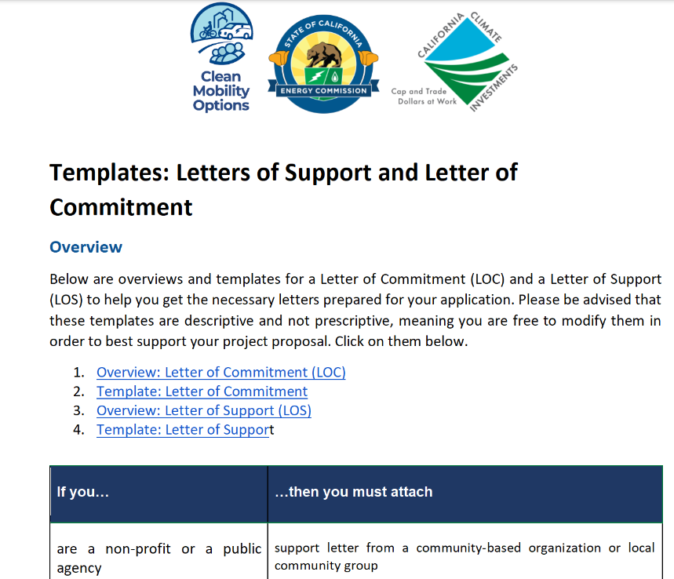
Section 3: Letters of Support (cont'd)
Example Template:
Letter of Support
Letter of commitment
Notes:
Sample letters of support available here: https://cleanmobilityoptions.org/support-letter-sample/

Slide 33
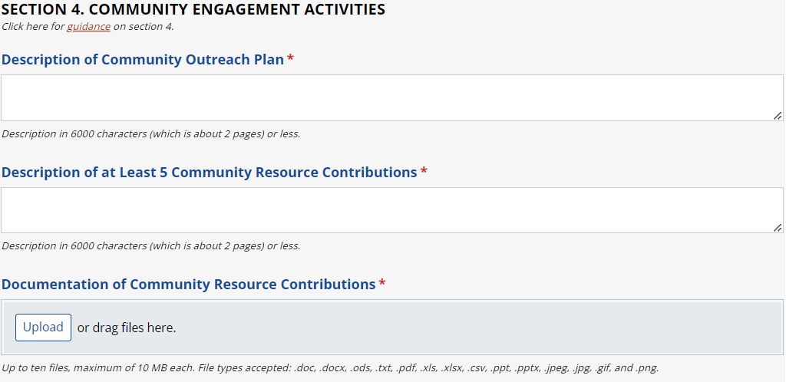
Section 4: Community Engagement Activities

Slide 34
Section 4: Community Outreach Plan
In the field "Description of Outreach Plan," provide a detailed description of the strategy to engage with residents through outreach and education.
This should include:
Identifying key partners, their roles, and knowledge of the community.
Describing activities to promote and advertise the service to potential users.
Plans to inform local business or stakeholders of construction or other elements of the project.

Slide 35
Section 4: Community Resource Contributions
In the field "Description of at Least 5 Community Resource Contributions," provide a list of a minimum of 5 eligible assets contributed to the project to support long-term sustainability of the project.
Resource Contributions do not need to be monetary, and you are not required to estimate the monetary value of contributions.
There is no minimum dollar amount or match requirement.
Any costs claimed as a resource contribution cannot be reimbursed through voucher funding.

Slide 36
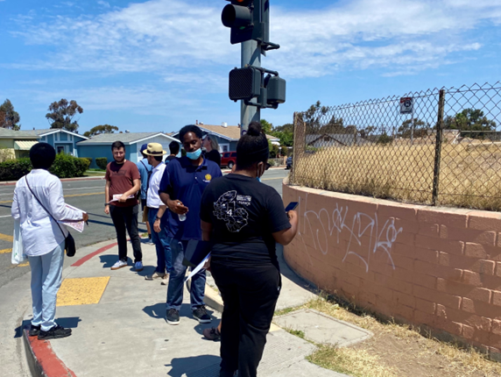
Section 4: Community Resource Contributions (cont'd)
Example Resource Contribution Types
Relationships with CBOs.
Project-related labor costs (up to one year prior to application date) for planning, labor, construction, etc.
Project-related labor costs during funding term but not paid for through CMO Voucher.
Materials, assets, technology, and equipment already owned and/or donated to the project to be used during the funding term.

Slide 37
Section 4: Community Resource Contribution Documentation
In the field "Documentation of Community Resource Contributions," provide (upload) at least one document to demonstrate each item described in the Community Resource Contribution field.*
Example Resource
Contribution
Example Resource Documentation
Relationship with CBO
Technology or Equipment
Additional Funding
Letter of Support
Purchase Documentation
Grant Agreement
*see Implementation Manual, Table 3 (pg 41) for a full list of eligible resource contribution types and examples of supporting documentation.

Slide 38
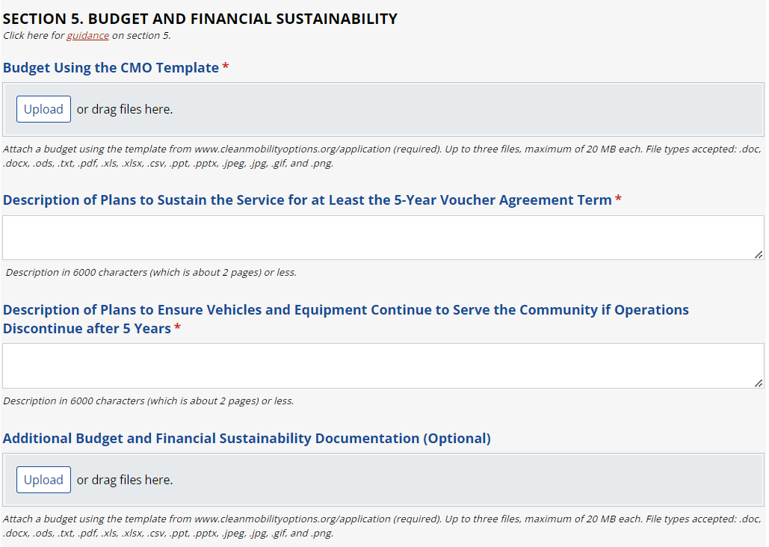
Section 5: Budget and Financial Sustainability

Slide 39
Section 5: CMO Budget
In the field "Budget Using the CMO Template," please upload your project budget using the CMO template available on the CMO website.
https://cleanmobilityoptions.org/mpv-budget-worksheet/
Ensure the total voucher amount requested is the same as the amount in Phase 1.
Provide a clear, concise budget.
This budget is the basis for future payment requests in CMO.
Notes:
Tell people to make sure the estimated budget matches what they applied for in Phase 1. If it doesn't, then it'll be kicked back. This will avoid unnecessary work by the CMO team to figure out what to do with "leftover money" if they actually apply for less

Slide 40
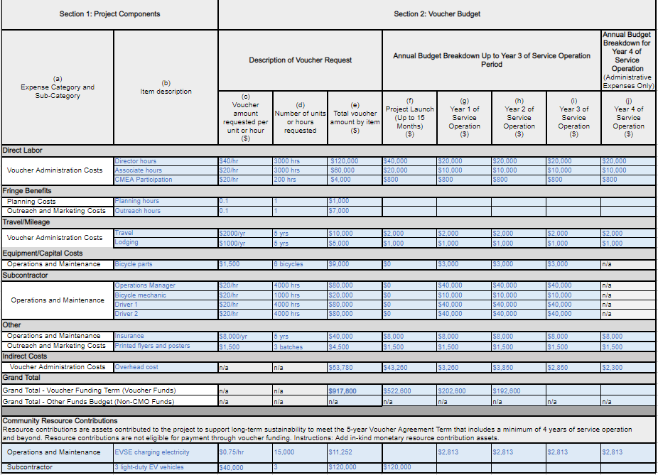
Section 5: CMO Budget (cont'd)

Slide 41
Section 5: Plan to Sustain Service
In the field "Description of Plans to Sustain the Service for at Least the 5-Year Voucher Agreement Term," describe plans to ensure the project can be sustainable after State funding is spent.
Discuss what will happen to project resources if the project does not continue beyond the 5-year term.
Describe strategies or contingency plans to make sure that vehicles and equipment purchased through CMO will still be used by the community if the service does not continue after the voucher term.

Slide 42
Section 5: Vehicles and Equipment
In the field "Description of Plans to Ensure Vehicles and Equipment Continue to Serve the Community if Operations Discontinue after 5 Years," discuss what will happen to project resources if the project does not continue beyond the 5-year term.
Describe strategies or contingency plans to make sure that vehicles and equipment purchased through CMO will still be used by the community if the service does not continue after the voucher term.

Slide 43
Section 5: Documentation
In the field "Additional Budget and Financial Sustainability Documentation,"
Provide documentation to validate any plans or expectations described in the previous two fields.

Slide 44
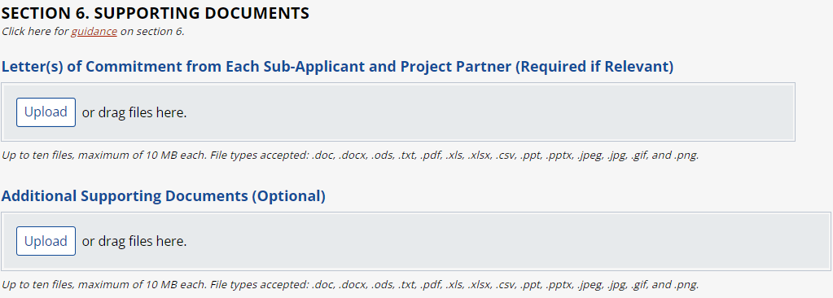
Section 6: Supporting Documents

Slide 45
Section 6: Supporting Documents
The field "Letter(s) of Commitment from Each Sub-Applicant and Project Partner," will appear for applicants that indicated that the application includes sub applicants.
Applicants may choose to submit letters of commitment here or wait until after potential voucher award (but must have before voucher execution).
Each letter must include the sub-applicant's specific roles and responsibilities to the project.

Slide 46
Section 6: Supporting Documents cont.
The field "Additional Supporting Documents (Optional)," applicants may submit documentation to support responses to questions in any section of the application.
Applicants should indicate the field for which the document is purposed.
This field is optional.

Slide 47
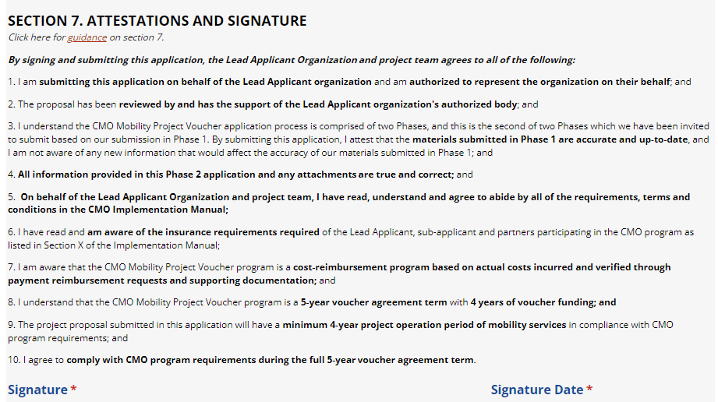
Section 7: Attestation and Signature

Slide 48
Section 7: Signature and Attestation
The primary contact must complete the "Signature Fields."
This section forms an agreement that the primary contact, on behalf of the Lead Applicant, acknowledges and will comply with critical program and application rules and procedures.
Please ensure that the whole team including legal counsel has read through and agrees to comply with all requirements for the application and potential voucher award.

Slide 49
Questions?
REMINDER
Prior to asking questions, please state:
Full name
Organization

Slide 50
MPV Application Phase 2 Recap and Next Steps
highlighting important points to remember and highlights important points to remember.

Slide 51
MPV Phase 2 Application Recap
Applicants must submit Phase 2 Requirements by August 16, 2023:
Project Narrative
Project Milestone Schedule
Community Outreach Plan
Community Resource Contribution
Budget Worksheet
Financial Sustainability Plan
Supporting Doc (where applicable)
Applicants will receive Notice of Intent to Award email from Administration Team when all required documents have been submitted, reviewed and approved on a rolling basis.
Notes:
Develop Phase 2 of your application utilizing support from your technical assistance advocate.
Submit your Phase 2 application by the application deadline. You may submit your application at any time before the deadline.
Move on to voucher execution and reimbursement.

Slide 52
MPV Phase 2 Next Steps
After your project receives a Notice of Intent to Award from Program Administration Team, then…
Awardee has up to 180 business days to execute the CMO Voucher Agreement.
The time and work to complete the MPV application is not reimbursable.
After the execution of the voucher agreement awardees may begin incurring costs towards administrative activities such as insurance materials and other requirement documentation to the Program Administrator.
Additional trainings are required.
Awardee has up 15 months to launch service from Voucher Agreement Execution.
Notes:
Develop Phase 2 of your application utilizing support from your technical assistance advocate.
Submit your Phase 2 application by the application deadline. You may submit your application at any time before the deadline.
Move on to voucher execution and reimbursement.
Please note that after awarded, this will not be public until vouchers are executed. Also, remind them that none of the work to put this application together can be reimbursed

Slide 53
Thank You

